Slide 1
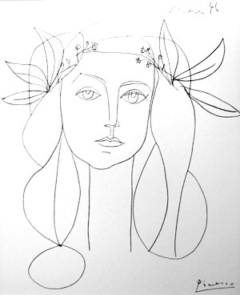
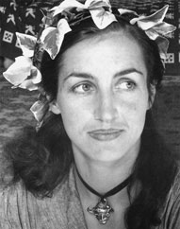
Image Features Class 1
Picasso, 1946
Francoise Gilot

Slide 2
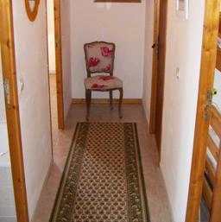



Matching a Template
C
R
Distance
(minimum)
${\left||C−R\right||}^{2}$=|${\left|C|\right|}^{2} +{|\left|R\right||}^{2}−2R^{T}⋅$C
Correlation
(maximum)
$$R^{T}⋅C$$
Image Region (R)
Normalize Correlation
A chair
(maximum)
$$\frac{R^{T}⋅C}{\left|\left|R\right|\right|\left|C\right||}$$
Template (C)
Find the chair
Adapted from Torralba

Slide 3
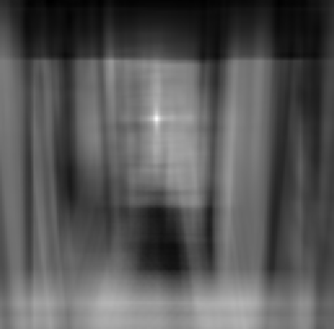
Matching a Template
A chair
Find the chair
Output of normalized
correlation
Adapted from Torralba

Slide 4
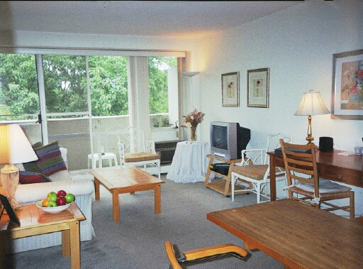
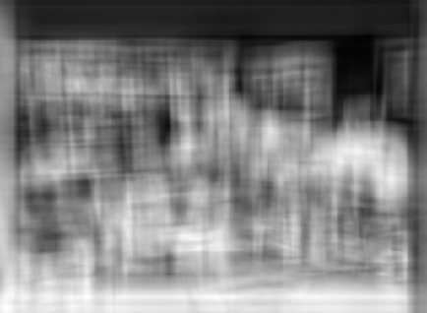
Matching Object
Not good enough!
Why?
Adapted from Torralba

Slide 5
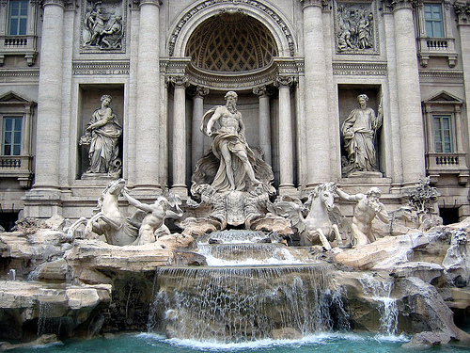
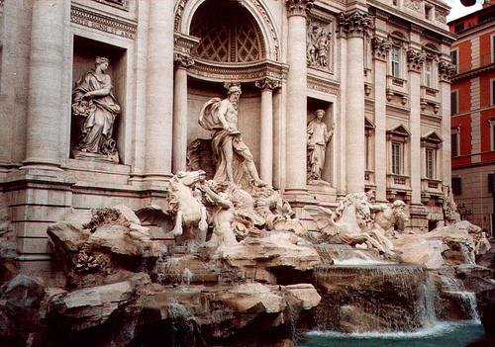
Matching Image Regions (patches)
50
true match
75
200
false match
feature distance
Trevi Fountain, Rome
Which regions ?

Slide 6
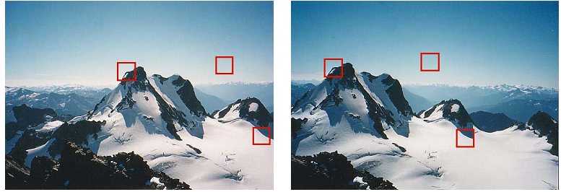


Image Features
Location
Descriptors
Matching
Taken from Szeliski

Slide 7
Image Feature Matching
Used for recognizing:
Object, scene, action…
Geometry:
Camera calibration
3D reconstruction
Navigation
Tracking
More …

Slide 8
Desired Properties
Efficient to compute
Key point location:
Invariant
Sufficient number
Descriptor
Robust to variations
Matching

Slide 9
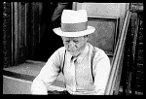
Basic Image Features
Specific to objects
Regions
Contours:
Gray (color) edges
Circles, ….
Points (corners, ..)
CNN features
Today
Evan Walker, 1903-1975

Slide 10
Matching, What?
Images
Scenes
Places
Objects (people, cars, heart, …)
Patches
Image feature

Slide 11
Interest Points + Edges
A corner
Maxima curvature
Bitangent point
Inflection point
Edge point:
Change from dark to light
Next week

Slide 12
Corners

Slide 13
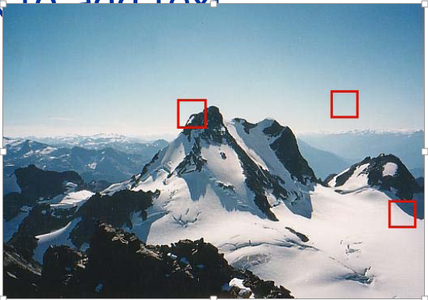
Observation
Shift correlation
No texture
Edge
“corner”

Slide 14
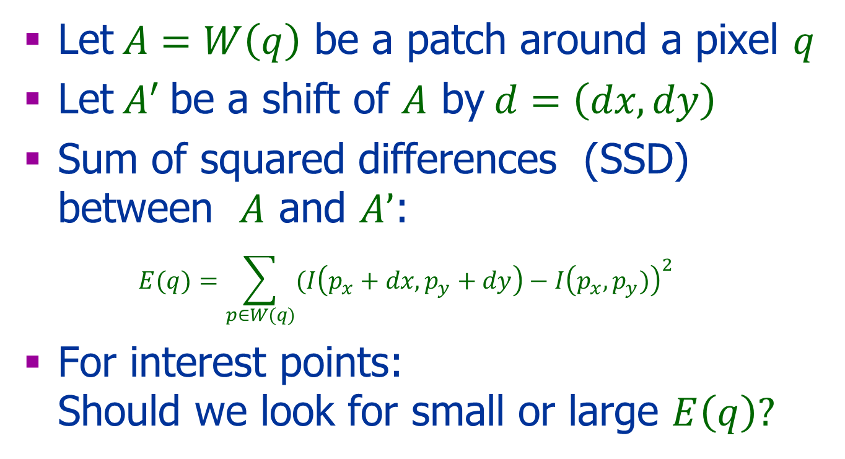
Shift Correlation
Let$A=W\left(q\right)$ be a patch around a pixel $q$
Let$A^{′}$ be a shift of $A$ by$d=\left(dx,dy\right)$
Sum of squared differences (SSD) between $A$ and $A’$:
$$E(q)=\sum_{p∈W(q)}{(I\left(p_{x}+dx,p_{y}+dy\right)−I{\left(p_{x},p_{y})\right)}^{2}}$$
For interest points: Should we look for small or large $E\left(q\right)?$

Slide 15

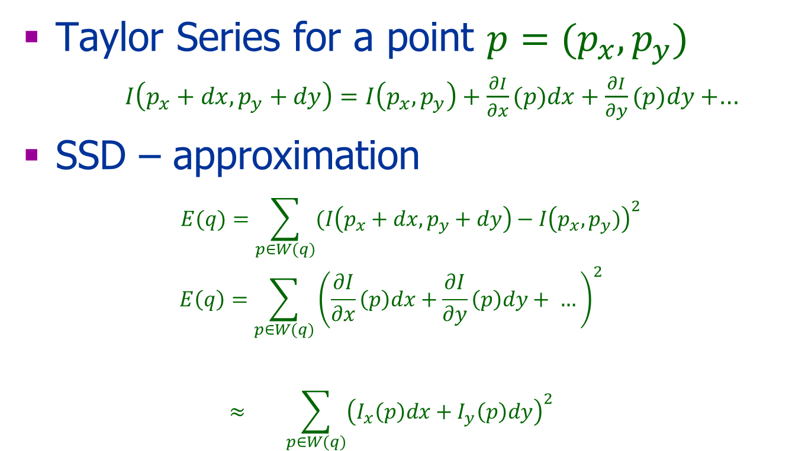

Efficient Computation
Taylor Series for a point $p=(p_{x},p_{y})$
$I\left(p_{x}+dx,p_{y}+dy\right)=I\left(p_{x},p_{y}\right)+\frac{∂I}{∂x}(p)dx+\frac{∂I}{∂y}(p)dy+$…
SSD – approximation $E(q)=\sum_{p∈W(q)}{(I\left(p_{x}+dx,p_{y}+dy\right)−I{\left(p_{x},p_{y})\right)}^{2}}$
$$E\left(q\right)=\sum_{p∈W(q)}{{\left(\frac{∂I}{∂x}\left(p\right)dx+\frac{∂I}{∂y}\left(p\right)dy+ …\right)}^{2}}$$
$$≈ \sum_{p∈W(q)}{{\left(I_{x}\left(p\right)dx+I_{y}\left(p\right)dy\right)}^{2}}$$
$$W\left(q\right) a patch$$
$$I_{x}= \frac{∂I}{∂x}$$

Slide 16

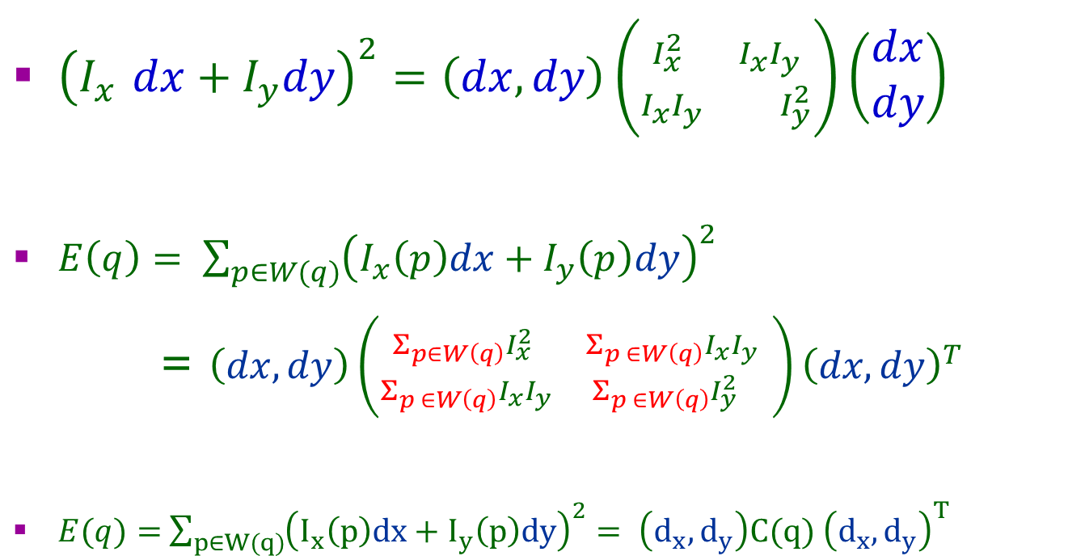
Some Algebra
${\left(I_{x}^{}dx+I_{y}dy\right)}^{2}=\left(dx,dy\right)\left({I_{x}^{2} I_{x}I_{y} \atop I_{x}I_{y} I_{y}^{2}}\right){\left(\begin{aligned}dx \\ dy\end{aligned}\right)}^{}$
$E\left(q\right)= \sum_{p∈W(q)}{{\left(I_{x}\left(p\right)dx+I_{y}\left(p\right)dy\right)}^{2}}$
= $\left(dx,dy\right)\left({{Σ_{p∈W\left(q\right)}I}_{x}^{2} Σ_{p ∈W\left(q\right)}I_{x}I_{y} \atop Σ_{p ∈W\left(q\right)}I_{x}I_{y}{ Σ}_{p ∈W\left(q\right)}I_{y}^{2} }\right){\left(dx,dy\right)}^{T}$
$E(q)=$ $\sum_{p∈W(q)}{{\left(I_{x}\left(p\right)dx+I_{y}\left(p\right)dy\right)}^{2}= \left(d_{x},d_{y}\right)C(q) {\left(d_{x},d_{y}\right)}^{T}}$
$$C(q)$$

Slide 17
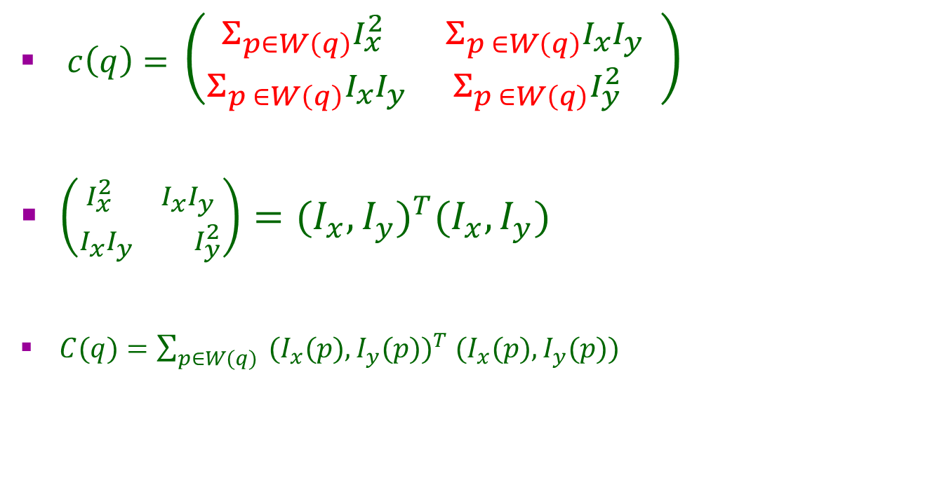
Some Algebra
$c\left(q\right)=$ $\left({{Σ_{p∈W\left(q\right)}I}_{x}^{2} Σ_{p ∈W\left(q\right)}I_{x}I_{y} \atop Σ_{p ∈W\left(q\right)}I_{x}I_{y}{ Σ}_{p ∈W\left(q\right)}I_{y}^{2} }\right)$
$\left({I_{x}^{2} I_{x}I_{y} \atop I_{x}I_{y} I_{y}^{2}}\right)={{(I}_{x},I_{y})}^{T}{(I}_{x},I_{y})$
$C(q)=\sum_{p∈W(q)}{ {{(I}_{x}(p),I_{y}(p))}^{T} (I_{x}(p),I_{y}(p)) }$

Slide 18
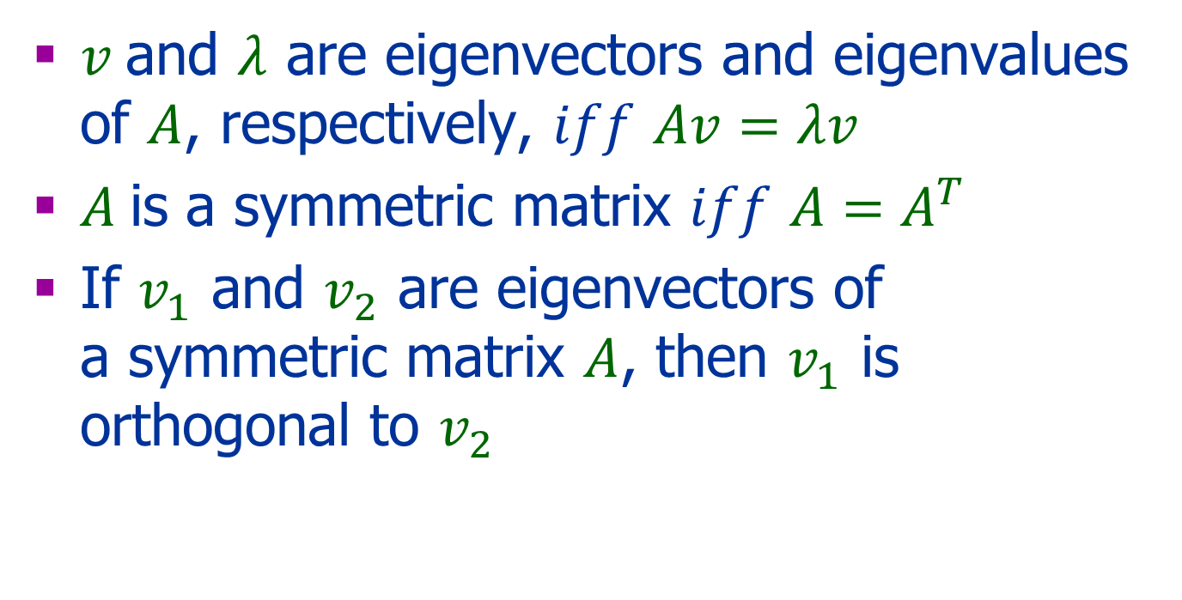
Reminder
$v$and $λ$ are eigenvectors and eigenvalues of $A$, respectively, $iff$ $Av=λv$
$A$ is a symmetric matrix $iff$ $A=A^{T}$
If $v_{1}$ and $v_{2}$ are eigenvectors of a symmetric matrix $A$, then $v_{1}$ is orthogonal to $v_{2}$

Slide 19
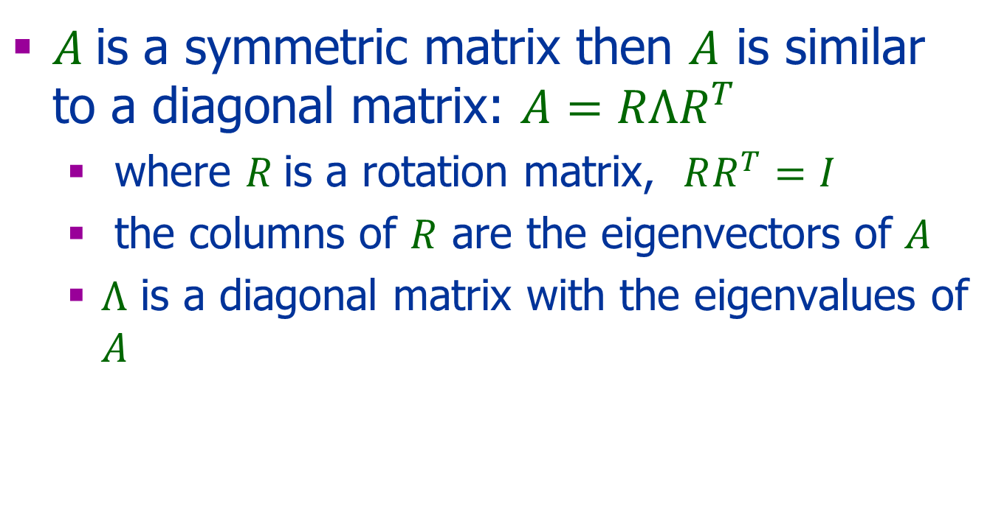
Reminder
$A$ is a symmetric matrix then $A$ is similar to a diagonal matrix: $A=RΛR^{T}$
where $R$is a rotation matrix, $RR^{T}=I$
the columns of $R$ are the eigenvectors of $A$
$Λ$ is a diagonal matrix with the eigenvalues of $A$

Slide 20
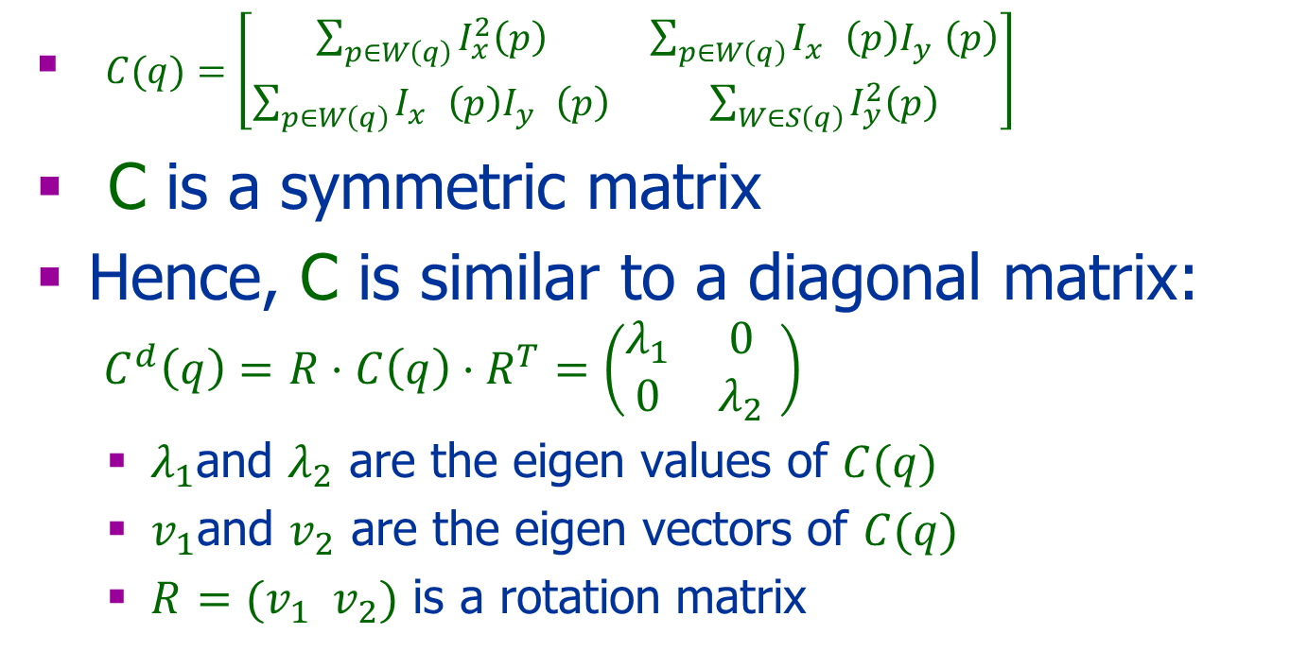
Harris Matrix
$C(q)=\left[\begin{matrix}\sum_{p∈W\left(q\right)}{I_{x}^{2}\left(p\right)} & \sum_{p∈W\left(q\right)}{I_{x}^{} \left(p\right)I_{y}^{}\left(p\right)} \\ \sum_{p∈W\left(q\right)}{I_{x}^{} \left(p\right)I_{y}^{} \left(p\right)} & \sum_{W∈S\left(q\right)}{I_{y}^{2}\left(p\right)}\end{matrix}\right]$
C is a symmetric matrix
Hence, C is similar to a diagonal matrix: $C^{d}\left(q\right)=$ $R⋅C\left(q\right)⋅R^{T}=\left(\begin{matrix}λ_{1} & 0 \\ 0 & λ_{2}\end{matrix} \right)$
$λ_{1}$and $λ_{2}$ are the eigen values of $C(q)$
$v_{1}$and $v_{2}$ are the eigen vectors of $C(q)$
$R$ $=(v_{1} v_{2})$ is a rotation matrix

Slide 21

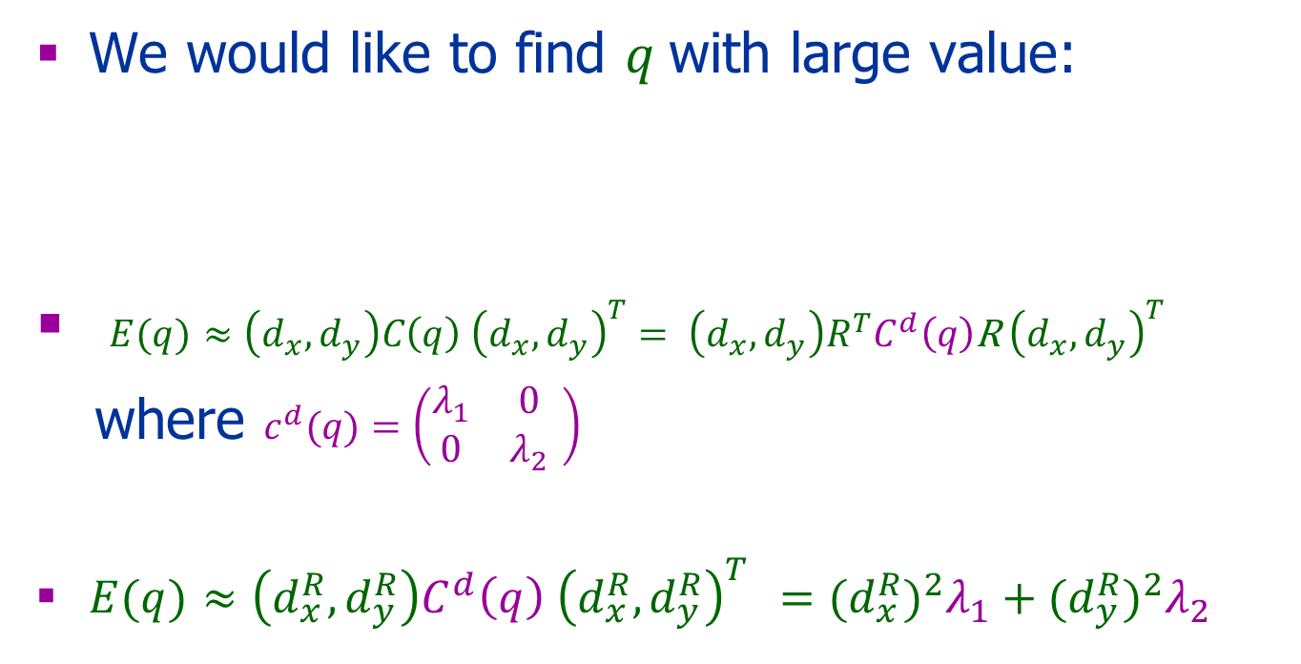

Back to Our Goal
We would like to find $q$with large value:
$E(q)$ $≈\left(d_{x},d_{y}\right)C\left(q\right) {\left(d_{x},d_{y}\right)}^{T}= \left(d_{x},d_{y}\right)R^{T}C^{d}\left(q\right)\text{R} {\left(d_{x},d_{y}\right)}^{T}$
where $c^{d}(q)=\left(\begin{matrix}λ_{1} & 0 \\ 0 & λ_{2}\end{matrix} \right)$
$E(q)$ $≈\left(d_{x}^{R},d_{y}^{R}\right)C^{d}\left(q\right) {\left(d_{x}^{R},d_{y}^{R}\right)}^{T}$ $={{(d}_{x}^{R})}^{2}λ_{1}+{{(d}_{y}^{R})}^{2}λ_{2}$
$$E(q)=\sum_{p∈W(q)}{(I\left(p_{x}+dx,p_{y}+dy\right)−I{\left(p_{x},p_{y})\right)}^{2}}$$
$${\left(d_{x}^{R},d_{y}^{R}\right)}^{T}$$

Slide 22

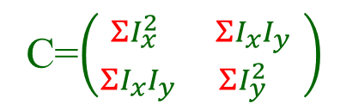
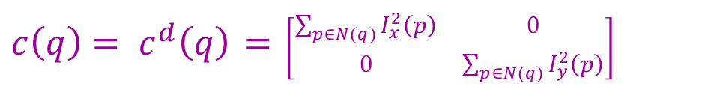
Observations
C=$\left({{ΣI}_{x}^{2} ΣI_{x}I_{y} \atop ΣI_{x}I_{y} ΣI_{y}^{2} }\right)$
For upright Corner
Horizontal edge: $I_{x}^{2}\left(p\right)=0 \&{ I}_{y}^{2}(p)$>0
Vertical edge: $I_{x}^{2}\left(p\right)>0 \&{ I}_{y}^{2}(p)$ = 0
Vertical or horizontal edge, or in a constant region:${ I}_{y}^{}\left(p\right){⋅I}_{y}^{}\left(p\right)=0$
Corner: $I_{x}^{2}\left(p\right)>0 ,{ I}_{y}^{2}(p)$ > 0
${c\left(q\right)= c}^{d}\left(q\right)$ $=$ $\left[\begin{matrix}\sum_{p∈N(q)}{I_{x}^{2}\left(p\right)} & 0 \\ 0 & \sum_{p∈N(q)}{I_{y}^{2}\left(p\right)}\end{matrix}\right]$

Slide 23
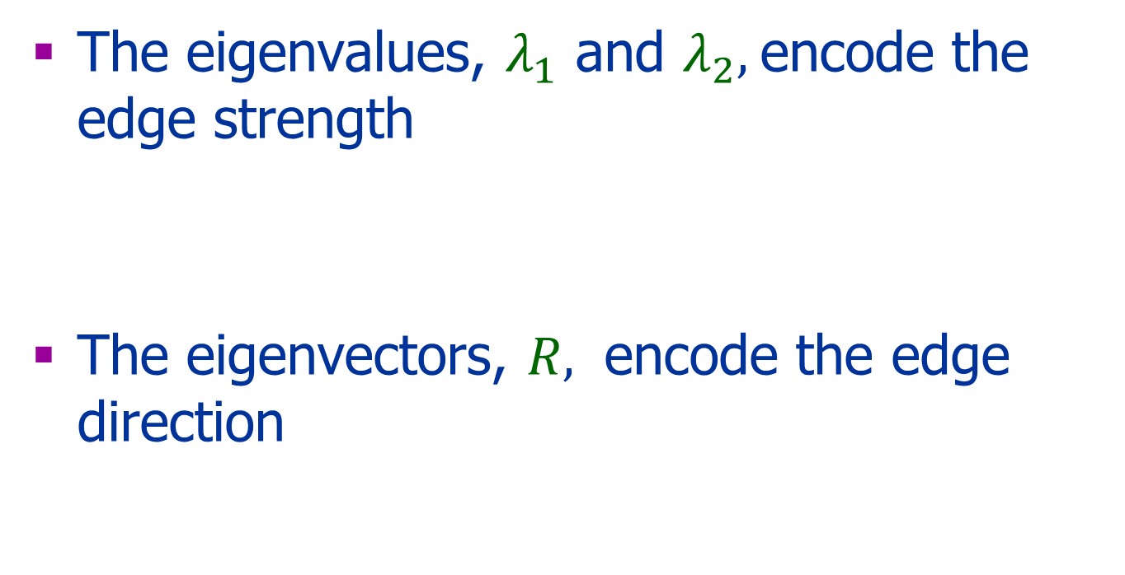

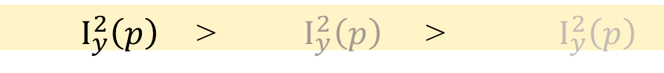
Edge Direction & Strength
The eigenvalues, $λ_{1}$ and $λ_{2},$encode the edge strength
The eigenvectors, $R,$ encode the edge direction
$I_{y}^{2}\left(p\right)$ > $I_{y}^{2}\left(p\right)$ > $I_{y}^{2}\left(p\right)$
$$R$$

Slide 24
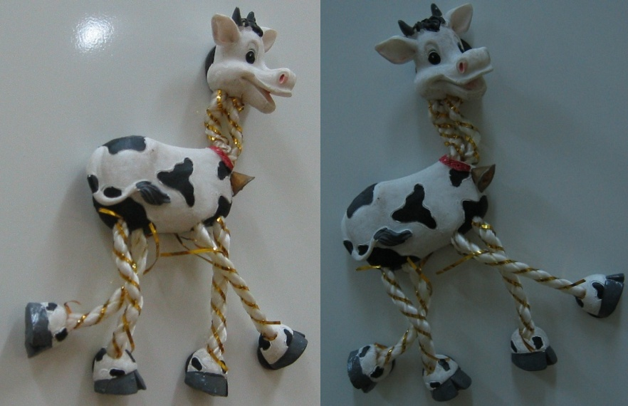
Harris Detector: Workflow

Slide 25
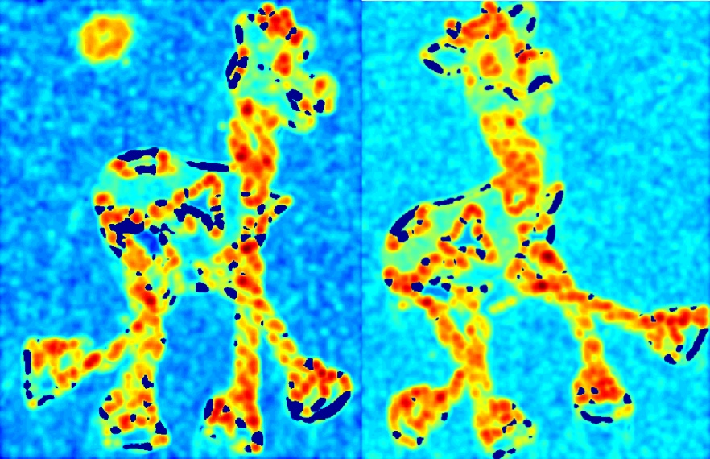
Harris Detector: Workflow
Compute corner response d

Slide 26
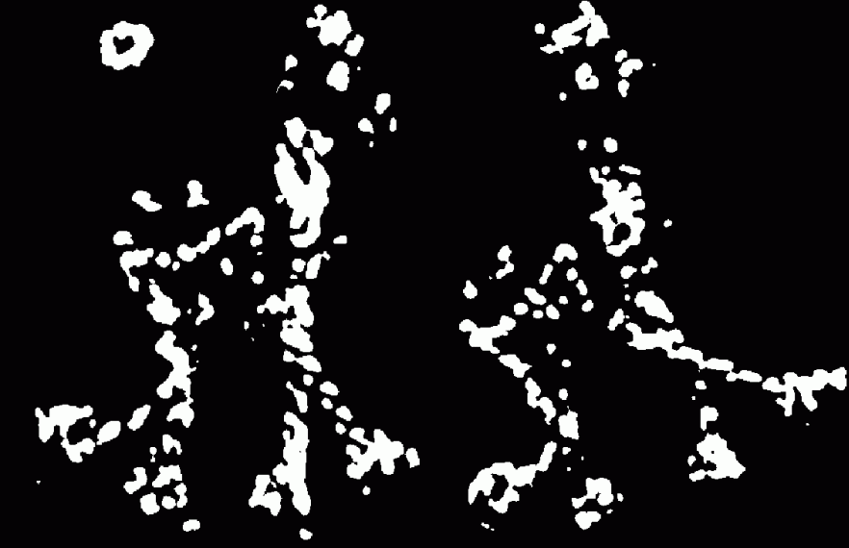
Harris Detector: Workflow
Find points with large corner response: d>threshold

Slide 27
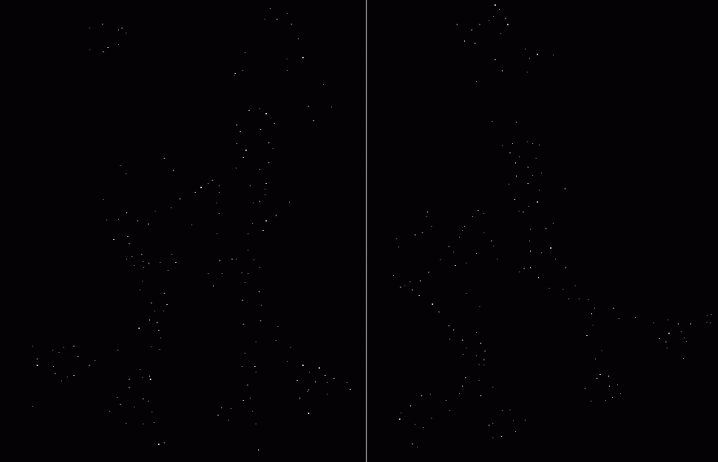
Harris Detector: Workflow
Take only the points of local maxima of d

Slide 28
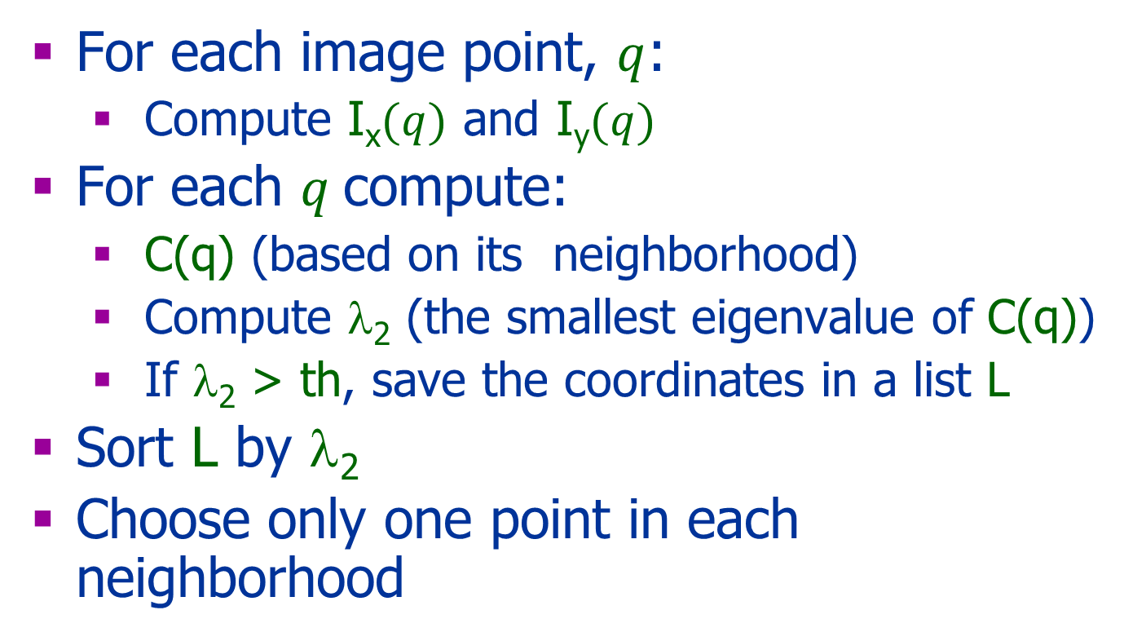
Harris Corner Detector Algorithm
For each image point, $q$:
Compute I_{x}$(q)$ and I_{y}$(q)$
For each $q$compute:
C(q) (based on its neighborhood)
Compute λ₂ (the smallest eigenvalue of C(q))
If λ₂ > th, save the coordinates in a list L
Sort L by λ₂
Choose only one point in each neighborhood
How?

Slide 29
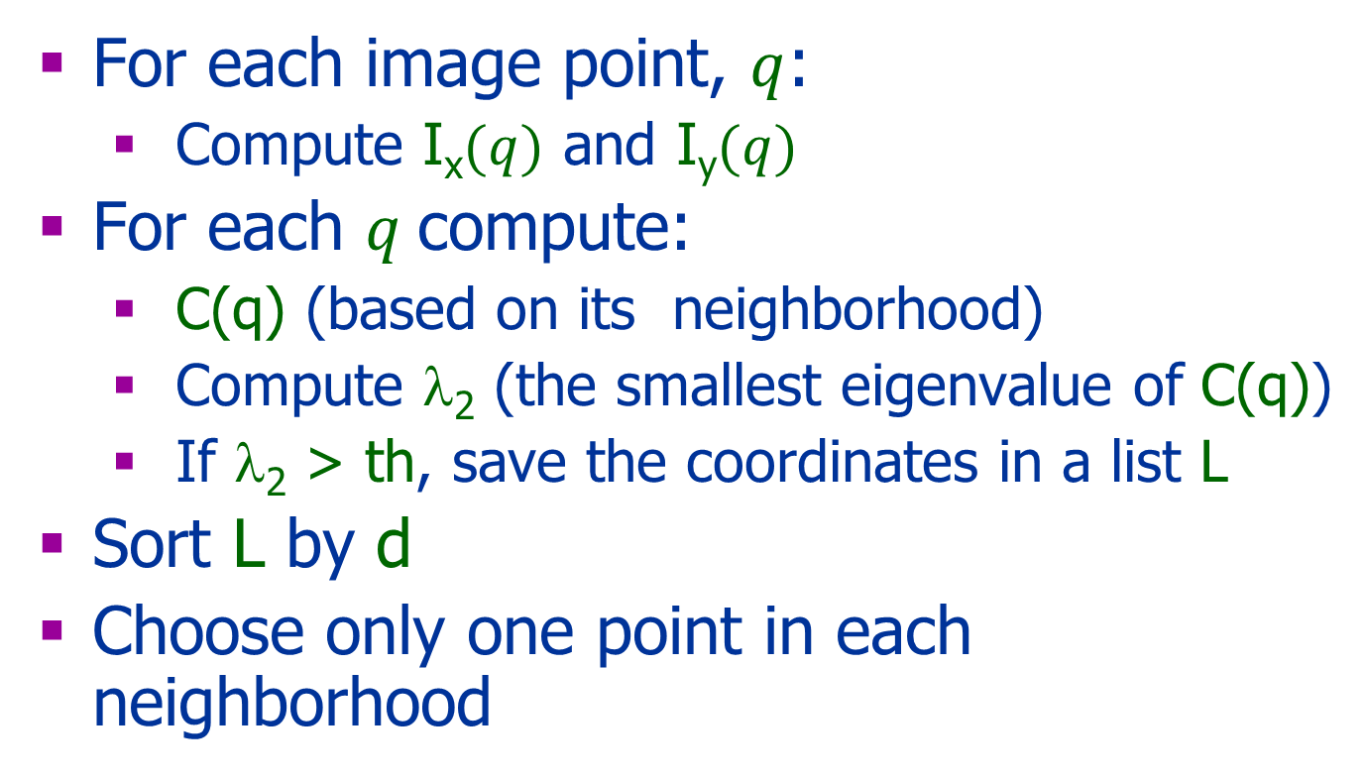
Harris Corner Detector Algorithm
For each image point, $q$:
Compute I_{x}$(q)$ and I_{y}$(q)$
For each $q$compute:
C(q) (based on its neighborhood)
Compute λ₂ (the smallest eigenvalue of C(q))
If λ₂ > th, save the coordinates in a list L
Sort L by d
Choose only one point in each neighborhood
Compute d(q)= λ₁ λ₂-k(λ1+ λ2)= det(C)-k*Trace(C)²
d(q)

Slide 30
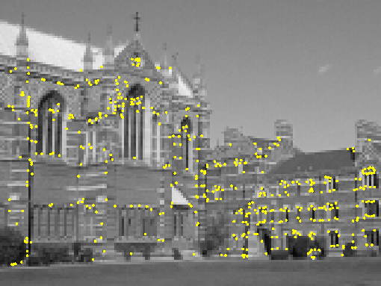
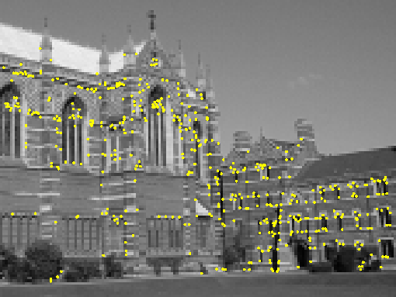
Harris Detector
Interest points extracted with Harris (~ 500 points)

Slide 31
Pause
What is missing???

Slide 32



Gradient: 2D
Given 2D function:$f(x,y)$
Gradient:
Denote by:
$I_{x}=\frac{∂I}{∂x}$ and $I_{y}=\frac{∂I}{∂y}$

Slide 33
How to compute it?

Slide 34


Derivatives & Discrete Derivatives
But …
The best we can do: $f\left(a+1\right)−f(a)$

Slide 35
Derivatives & Discrete Derivatives

Slide 36
Discrete Case
I_{x}(x,y)=I(x+1,y)-I(x,y)
I_{y}(x,y)=I(x,y+1)-I(x,y)

Slide 37

Convolution
A linear operator
Discrete 2D:
$A$ and $I$ are matrices
Continues 1D:
$f$, $g$ – functions

Slide 38
1D Convolution
a | b | c
*
1 | 2 | 3
=
A
I
0 | 0 | 0
a | b | c
0 | 0 | 0
3
2
3
1
2
3
1
2
1
3
2
1
3
2
1
=
0 | a | 2a+b | 3a+2b+c | 3b+2c | 3c | 0

Slide 39

Cross Correlation vs. Convolution
$I= K=$
Convolution
$I∗K=$
$K∗I=$
Cross-correlation (no reflection)
$I∗_{cor} K=$
$K∗_{cor}I=$
0 1 2 3 0
0 1 2 0
0 1 4 7 6
0 1 4 7 6
0 2 5 8 3
0 3 8 5
2

Slide 40
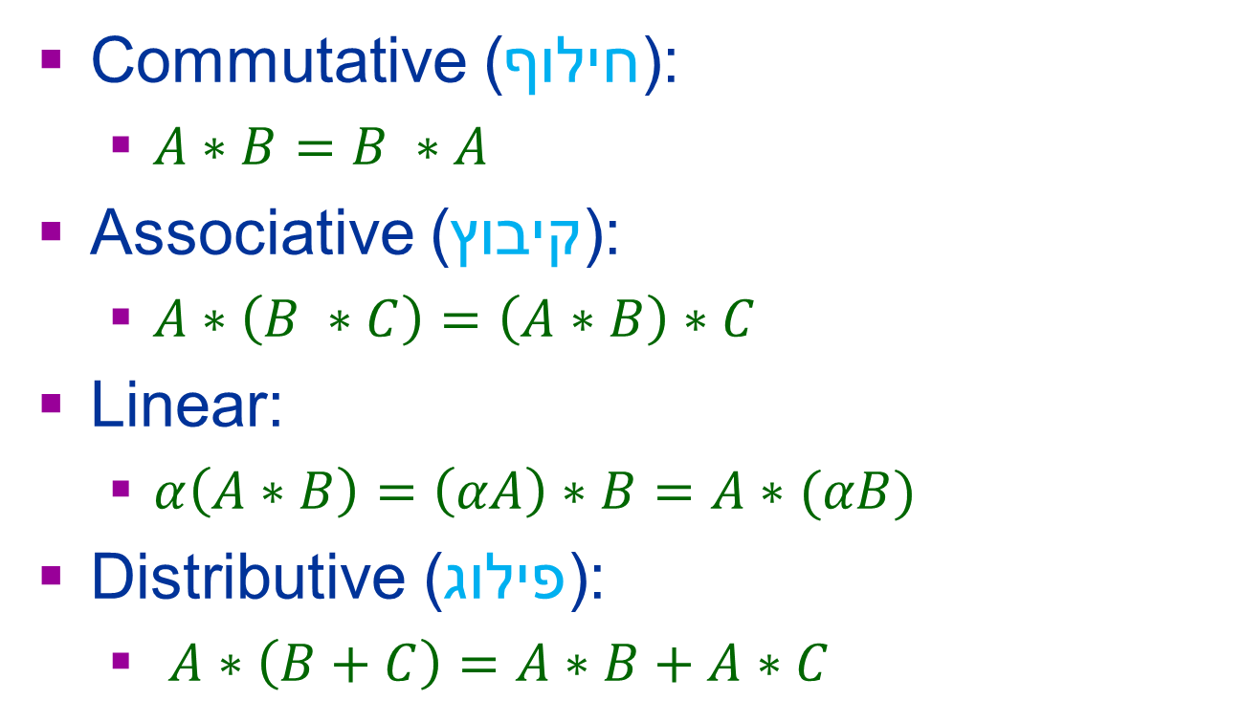
Convolution Properties
Commutative (חילוף):
$A∗B=B ∗A$
Associative (קיבוץ):
$A∗\left(B ∗C\right)=\left(A∗B\right)∗C$
Linear:
$α\left(A∗B\right)=\left(αA\right)∗B=A∗(αB)$
Distributive (פילוג):
$A∗\left(B+C\right)=A∗B+A∗C$

Slide 41
2D Convolution
Y | X | X+1 | X+2 | X+3 | X+4 | X+5
 | I₁ | I₂ | I₃ | I₄ | I₅ | I₆
Y+1 | I₇ | I₈ | I₉ | I₁₀ | I₁₁ | I₁₂
Y+2 | I₁₃ | I₁₄ | I₁₅ | I₁₆ | I₁₇ | I₁₈
Y+3 | I₁₉ | I₂₀ | I₂₁ | I₂₂ | I₂₃ | I₂₄
Y+4 | I₂₅ | I₂₆ | I₂₇ | I₂₈ | I₂₉ | I₃₀
Y+5 | I₃₁ | I₃₂ | I₃₃ | I₃₄ | I₃₅ | I₃₆
*K₁ | *K₂ | *K₃
*K₄ | *K₅ | *K₆
*K₇ | *I₈ | *K₉
*K₁ | *K₂ | *K₃
*K₄ | *K₅ | *K₆
*K₇ | *I₈ | *K₉
*K₁ | *K₂ | *K₃
*K₄ | *K₅ | *K₆
*K₇ | *I₈ | *K₉
*K₁ | *K₂ | *K₃
*K₄ | *K₅ | *K₆
*K₇ | *I₈ | *K₉
*K₁ | *K₂ | *K₃
*K₄ | *K₅ | *K₆
*K₇ | *I₈ | *K₉
*K₁ | *K₂ | *K₃
*K₄ | *K₅ | *K₆
*K₇ | *I₈ | *K₉

Slide 42
Discrete Differential Operators
Convolution Mask
Notes:
To explain how the second derivatives are computed.
Which derivatives are computed in each of them?
I_{x} I_{y} I_{x}² (the derivative of the first derivative).

Slide 43
Noise
An image is a physical measurement that is subject to noise
Due to: sampling, quantization, etc
Handling noise:
Smooth the image

Slide 44
Simple Smoothing
Average neighborhood convolution mask
I(x-1,y)+I(x,y)+I(x+1,y)
I(x-1,y)+2*I(x,y)+I(x+1,y) [1 2 1]
I(x-1,y-1)+I(x,y-1)+I(x+1,y-1) +
I(x-1,y)+2*I(x,y)+I(x+1,y)+
I(x-1,y+1)+I(x,y+1)+I(x+1,y+1)
Normalization the mask
Gaussian
[1 1 1]

Slide 45
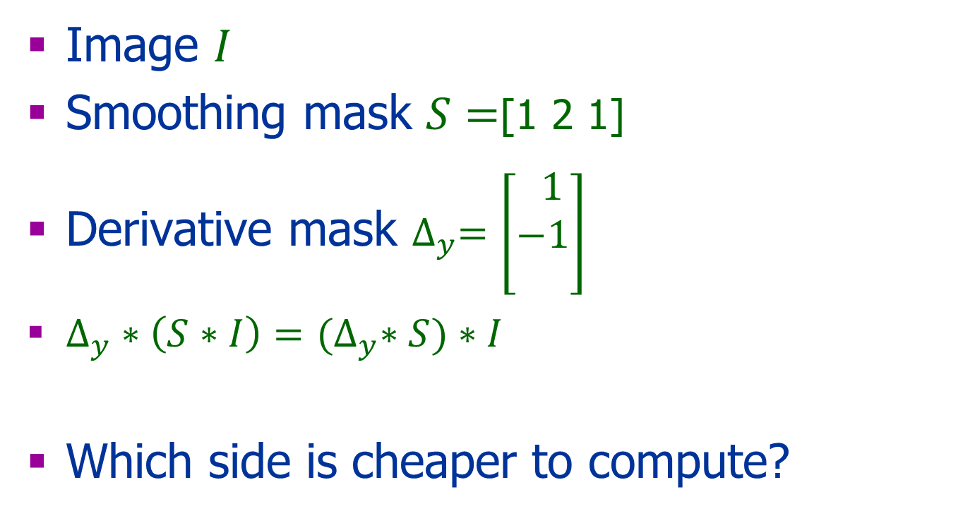
Simple Smoothing
Image $I$
Smoothing mask $S=$[1 2 1]
Derivative mask $∆_{y}=\left[\begin{aligned} 1 \\ −1 \\ \end{aligned}\right]$
$∆_{y}∗\left(S∗I\right)=$ ${(∆}_{y}∗S)∗I$
Which side is cheaper to compute?

Slide 46
Smoothing and Taking Derivatives
or
Smoothing
Notes:
To explain how the second derivatives are computed.
Which derivatives are computed in each of them?
I_{x} I_{y} I_{x}² (the derivative of the first derivative).

Slide 47
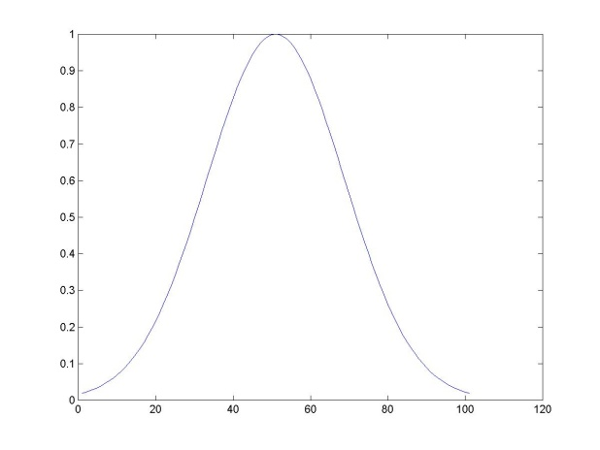
Gaussian Filter
The best function that is localized in the spatial and frequency (scale) domains
Notes:
Any idea why we use 1/2pi..?

Slide 48
Today
Defined a corner by shift-variant
Harris corner detector - algorithm
Smoothing – will finish next class
Convolution -

Slide 49
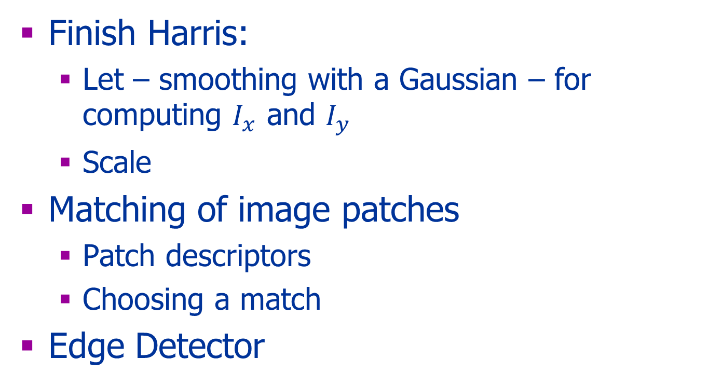
Next Class
Finish Harris:
Let – smoothing with a Gaussian – for computing $I_{x}$ and $I_{y}$
Scale
Matching of image patches
Patch descriptors
Choosing a match
Edge Detector

